Slide 1
Climate Change, Forest Fires and common bets for the protection of the Amazon
Rathna Kewal
Climate Change Coordinator
Amazon Cooperation Treaty Organization

Slide 2
Content
Amazon
Who are we
Mission
Amazon Cooperation Treaty Organization
Belém Declaration
Environmental Challenges
Climate Change in Belém Declaration
Programs
RES/XIV MRE-OTCA 24
RES/XIV MRE-OTCA 25
RES/XIV MRE-OTCA 22
Forest Fires
Conclusions

Slide 3
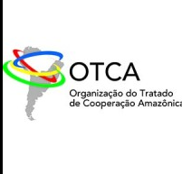
Amazon
10% of the world's known biodiversity
20% of the world's drinking water
The largest and most biodiverse tropical forest on the planet

Slide 4
Water resources
Population and economy
Regional and global water reserve.
Regulates planetary and regional climate (carbon sequestration and evapotranspiration processes).
Approximately 50 million inhabitants.
+ than 420 indigenous peoples.
+370 languages
53% from rural activities.
31% trade.
16% manufacturing.
70% in urban areas.
Biodiversity and Ecosystems
Endemic species: 30,000 plant species, 3,000 fish species, 384 amphibian species, 550 reptile species, 950 bird species, 350 mammal species and 57 primate species.
67.4% tropical forest and 13.3% tropical savannas.

Slide 5
Who are we
The ACTO, made up of eight Amazonian countries, is a unique intergovernmental organization in Latin America, formed based on the Amazon Cooperation Treaty (ACT). Acting in several dimensions, such as political-diplomatic, strategic and technical, ACTO promotes synergies between governments, multilateral organizations, civil society, social movements and productive sectors to effectively implement the TCA and address socio-environmental issues in the Amazon region.

Slide 7
Amazon Cooperation Treaty Organization (ACTO)
- The Amazon Cooperation Treaty Organization (ACTO 1998), is the official mechanism of cooperation, convergence and political dialogue were its 8 Member Countries (Bolivia, Brazil, Colombia, Ecuador, Guyana, Perú, Suriname and Venezuela), who signed an Amazon Cooperation Treaty (ACT 1978)
- work in a coordinated manner, implementing programs, projects and initiatives, carrying out joint efforts and actions to promote sustainable development of their respective Amazonian territories, so that these joint actions produce equitable and mutually beneficial results.

Slide 8
How we work?
We jointly build regional policies, plans and action programs;
We implement regional programs, projects and activities;
We strengthen information, territorial intelligence and monitoring systems;

Slide 9
How we work?
We generate technical cooperation and capacity development;
We train human talent to understand and address regional issues;
We strengthen information, territorial intelligence and monitoring systems.

Slide 10
Belém Declaration ( August 2023)
- The eight countries of the ACTO sign the Belém Declaration during the Amazon Summit.
- The States Parties committed to taking actions to protect the biome and the river basin, promote social inclusion, foster science, technology and innovation, stimulate the local economy, with due consideration for indigenous peoples and local communities and traditions, including their ancestral knowledge.

Slide 11
113
Objetives
29
Resolutions

Slide 12
Environmental challenges in the Amazon
The Amazon plays a vital role in global climate stability and sustaining biodiversity. This vast region is fundamental in the absorption of carbon dioxide (CO2) and the release of oxygen, directly influencing global climate patterns.
The Amazon's dense vegetation cover acts as an immense carbon sink, helping to mitigate climate change by storing large quantities of this crucial gas.

Slide 13
Human Pressure
Climatic Events
Increase in deforestation

Slide 14
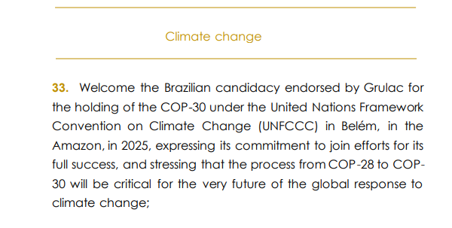
Climate change

Slide 15
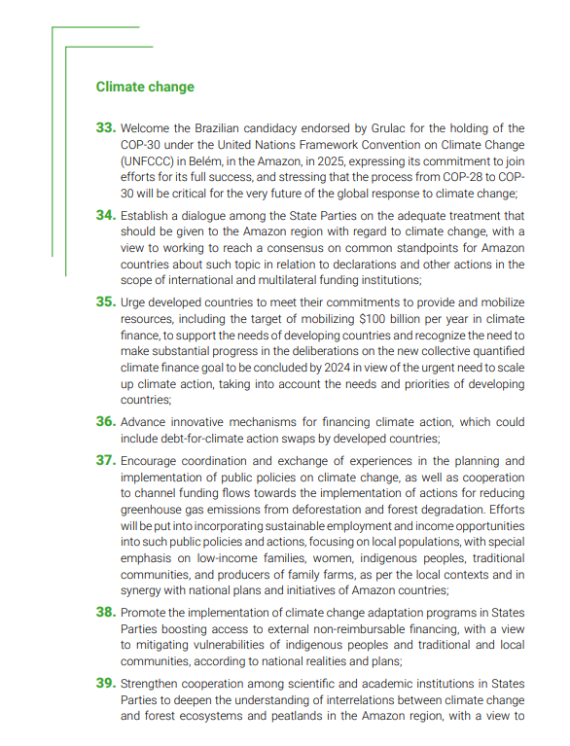
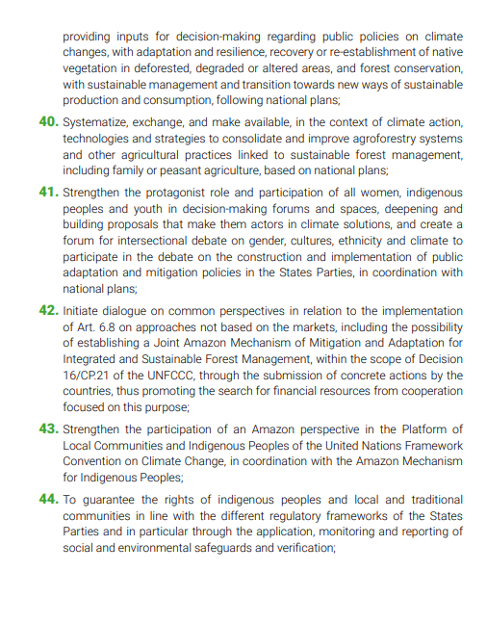
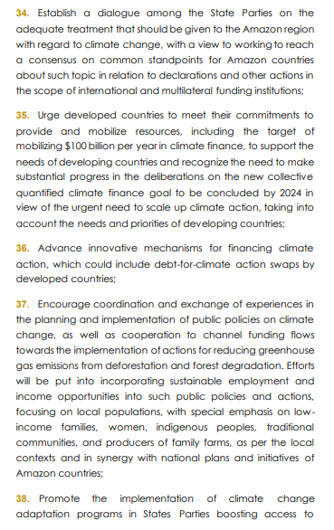
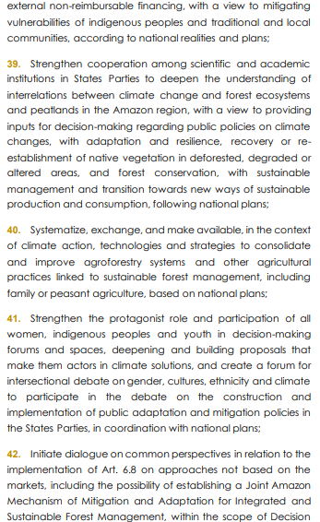
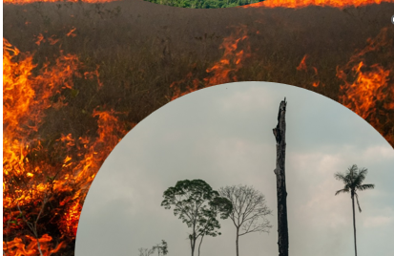

Slide 16
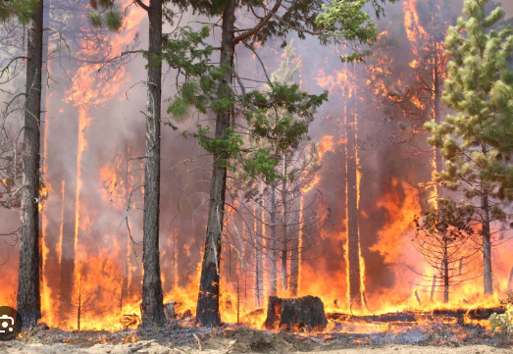
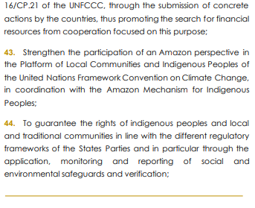

Slide 17
Programs ACTO, together with its MC, has worked for the conservation and sustainable use of its forests and the biodiversity associated with them.
Biodiversity: -Strengthen the capacities of all actors in the Amazon countries, in coordination and with the consent of the MC, for the management, conservation and sustainable use of biological diversity, based on regional cooperation
Forest:
To ensure the dissemination of tools, knowledge and content on technological and industrial development, agro-industries, bioeconomy and bio-trade in view of the challenges faced by companies/associations /cooperatives in creating and maintaining high added values in all links of forestry production chains and to promote social inclusion and the generation of local jobs.”
Today the ACTO MC count since 2021 with a Forest Regional Project for the Basin/Amazon Region promoting the Sustainable Forest Management in the region as well as developing training programs; fostering science, technology and innovation regarding the amazon species as to conserve the more valuable species; and promoting the socio-biodiversity.

Slide 18
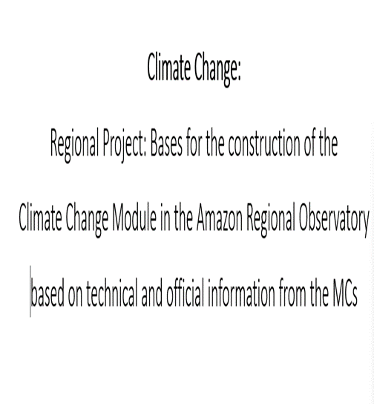

Slide 19
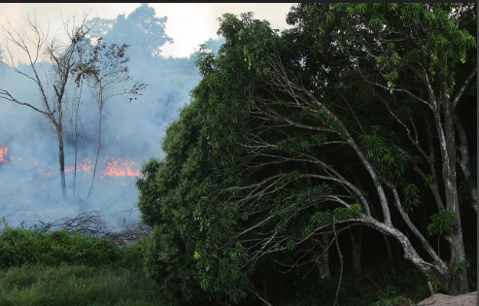
RES/XIV MRE-OTCA 24 – Forest Fires
Negotiation and adoption of a Framework Cooperation Agreement for the Fighting of Border Forest Fires in the ACTO MPs with the participation of international cooperation
- Develop a Cooperation System for Comprehensive Fire Management in the Amazon Region in order to address the ecological, social, environmental and technical aspects of fire in a comprehensive manner, which includes risk management and the fight against forest fires. in the Amazon countries.

Slide 20
Cooperation and Technical Assistance
PROGRAMS, PROJECTS AND INITIATIVES REGARDING INTEGRAL FIRE MANAGEMENT.
KNOWLEDGE MANAGEMENT AND EXCHANGE OF INFORMATION AND EXPERIENCES.
INFORMATION AND MONITORING
REGIONAL LEARNING PROGRAM,TRAINING, EXCHANGE OF EXPERIENCES AND INNOVATION
AMAZON NETWORK

Slide 21
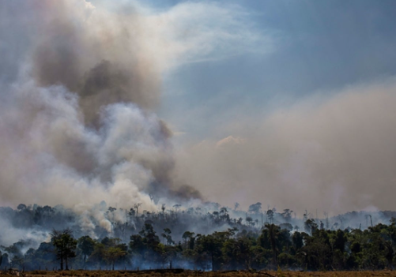
Forest
- Comprehensive fire management includes fire management; the ecology of fire; and the culture of fire. - Broad, holistic or completely unified approach to address issues related to fire, considering biological, environmental, cultural, social, economic and political interactions, and assuming that fire can generate positive and negative effects for the conservation of ecosystems and sustainable development.

Slide 22
The Memorandum of Understanding for Cooperation and Mutual Assistance for Integral Fire Management among ACTO Member Countries (MoU MIF) was technically approved in 2021 and adjusted in 2023. The MoU contemplates the Amazon Network for Integral Fire Management (RAMIF), and its Technical Group, as an integral part of it.
Forest
Deepen cooperation and joint actions to address forest fires, through the development of policies, instruments, technical actions, and use of innovation and technology, aimed at their prevention

Slide 23
The RAMIF and the Technical Working Group is in charge of the following actions, among others:
Establish the Cooperation System for Comprehensive Fire Management in the Amazon Region;
Develop and implement effective policies and strategies regarding comprehensive forest management and fire management, considering ecological, social, cultural and economic approaches;
Mobilize regional cooperation to activate early and timely alerts and responses according to the profiles of each affected country or countries;
Generate projects to access financing, international cooperation and climate funds;
Deepen the forest module in the ORA, emphasizing monitoring, forecasting of fires and heat sources;
Have a record of data from the collection of information on the loss of species, ecosystems, indigenous peoples and affected local communities.
Strengthen forest fire systems through training or knowledge transfer;

Slide 24
RES/XIV MRE-OTCA 25 – Regional Strategy and Humanitarian Assistance in the face of the Risks of the EL Niño Phenomenom
Cooperation, integrated vision and collective action is fundamental to address the political, social, economic and environmental challenges faced by adverse climate

Slide 25
Activities
Elaborate an Amazon strategy for Disaster Risk Management
Promote Exchange scientific information
The ARO currently issues periodic bulletins with information on the effects of El Niño Phenomenon and shares with the MC

Slide 26
RES/XIV MRE-OTCA/22-Joint Amazon Mitigation and Adaptation Mechanism for the Comprehensive and Sustainable Management of Forests
- In the context of the implementation of the Belém Declaration, the Department of Environment of the Ministry of Foreign Affairs of Brazil held the first virtual meeting on the “Amazon Alliance to Combat Deforestation.” - On this occasion, the countries presented their national policies to combat deforestation and presented their cooperation proposals (November 2023).

Slide 27
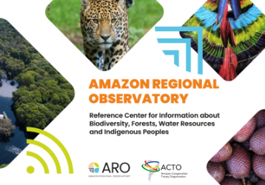
Regional ongoing Project
Strengthening and Expansion of the Amazon Regional Observatory (ARO) in the axes of Climate change, forests and Biodiversity

Slide 28
Activities
Baseline
Climate Change module in ARO
Sectoral Guides: - projects, plans, programs or other initiatives to guide the Member Countries on Climate and Environmental financing options
- Financial tool according to the sectoral guides -Strategic and action plan; approved by the Member Countries for the Resilient Amazon Initiative with emphasis on climate change - update of the forest and biodiversity module with current climate change issues

Slide 29
Observatorio
Regional Amazónico-November 2021
Forest module
A reference center for information in the Amazon that promotes the flow and exchange of information between institutions, government authorities, the scientific community, academia and civil society in the Amazonian countries of ACTO.
Early Alerts

Slide 30
Forest Fires
Since 2019 evidence of an increase in the occurrence of fires in the Amazon
September 2019: month with numerous occurrences recorded→ generated an international movement for awareness and fight against fires in the Amazon
Forest fire: - agricultural purposes, climatic conditions ( high temp, low humidity, etc)

Slide 31
Forest Fires
November 2021-ACTO launched the ARO; in its services a report panel with daily information on hot spots from NASA satellite data focused on the Amazon
Starting in 2022 also included information on fire-prone area forecasts ( provided by the Instituto de Pesquisas Espaciais-INPE) and fire occurrence polygons ( provided by the Centro de Gestão e Operação Amazônico-CENSIPAM-only focused on the Brazilian territory and since June 2023 providing information on fire occurrences in the Amazon

Slide 32
Forest Fires
ARO: daily data on total fire occurences in the Amazon → daily reports ( transboundary fire occurrences), weekly reports and generation of reports by country
Example: reports on the climate crisis 2023
Including death of about 170 river dolphins and 25 thousand tons of fish in the localities of Tefé and Coari, Manacapuru in the stretch of the Solimões River
Manaus Free Trade Zone in an standstill
Increased number of respiratory diseases

Slide 33
Conclusion
Role and Dynamic of the RAMIF initiative in fire prevention, monitoring and firefighting activities grom governmental initiatives is of vital importance
Necessary to increase the directory of institutions and persons receiving information from the bulletins and fire reports issued by ARO
Improve or complement the monitoring services for fire occurrences in the ORA with data ( prescribed burning, data from groundstations and data on criminal activities)

Slide 34
Conclusion
Urgent need to measure the effects of fire occurrences on biodiversity, health, economy, urban and indigenous populations
Knowledge of RAMIF and the actions articulated at national level
Capacity development at different levels

Slide 35
Thank You Rathna Kewal Climate Change Coordinator
Amazon Cooperation Treaty Organization rathna.kewal@otca.org

